Slide 1

Anonymity in XIA
Nicolas Feltman
David Naylor

Slide 2
Project Goals
CURRENT ANONYMITY METHODS
NEW ANONYMITY METHODS
USER AND DEVELOPER INTERFACE
Notes:
Our project goals were threefold.
Examine existing methods
Does XIA break anything?
Explore new methods
What new things does XIA let us do?
Consider interfaces for users and developers
How can users be brought into the loop and be given full control?
How can we encourage developers to allow for anonymity?
The first question we must cover is “what is anonymity?”

Slide 3
Anonymity is Unlinkability
ENTITIES
LEVEL
ATTACKER
MESSAGES
SENDER
RECIPIENT
IDENTITY
DENIABLE
PLAUSIBLE
PROVABLE
ISP
EMPLOYER
GOVERNMENT
RECIPIENT
UNLINKABILITY
Notes:
Anonymity can broadly be phrased as an issue of unlinkability.
That is: what is how unlinkable to whom?
If I’m looking at traffic from your machine, can I find out who you’re talking to?
If I’m the person you’re talking to, do you have to know who you are?

Slide 4
Project Goals
CURRENT ANONYMITY METHODS
NEW ANONYMITY METHODS
USER AND DEVELOPER INTERFACE
Notes:
One common current solution for various types of anonymity is…

Slide 5
Proxies
PROXY
?
SERVER
?
CLIENT
Notes:
…proxies.
The general idea of a proxy is to have a third party act as an intermediary between you and the target of your communications.
Done right, this can have two implications:
Firstly, since the recipient (which we’ll also call a server or webserver) only ever talks to the proxy, they only way they can find out the client’s identity is if you tell them as part of the message.
Additionally, any Man In The Middle between you and the proxy only sees communications between you and the proxy, so they wouldn’t know you’re really talking to the server.
In the current internet, this is implemented as a…

Slide 6


Existing Approach: Proxy
DEST: 187.14.2.1
SRC: 128.144.0.17
DEST: 89.22.22.11
DEST: 89.22.22.11
SRC: 187.14.2.1
REQUEST
REQUEST
128.144.0.17
DEST: 128.144.0.17
187.14.2.1
89.22.22.11
DEST: 187.14.2.1
SRC: 187.14.2.1
SRC: 89.22.22.11
SRC: 89.22.22.11
RESPONSE
RESPONSE
Notes:
…tunnel.
The idea is that you open a connection with the proxy, and that the protocol of this connection indicates that it should forward your messages on to the server.
With this little bit of anonymity out of the way, let move on to…

Slide 7
XIA Components
PRINCIPAL TYPES
DAG ADDRESSES
FLEXIBILE
EXPRESSIVE
EXTENSIBLE
Notes:
…XIA. Specifically, we’ll cover two aspects of the addresses.
The only agent of communication in the current internet is the host. That is, packets are always directed to a particular single machine. XIA generalizes communication to a set of principals, including hosts, but also including services, which are processes running on one or more machines, or to content (as in content based networking).
In addition to employing multiple principal types, XIA uses DAG-based addressing, allowing users to specify the intent of their communications
In particular, DAGs allows for expression of two things that make them useful for addressing; they are…

Slide 8
DAGs: Order and Fallback
Order
SID
AD
HID
Fallbacks
Notes:
ORDER and FALLBACKS
We’ve covered the idea of fallbacks pretty well in class, that being that if you can’t reach a goal directly, try some other route
But the other neat thing about DAGs is that they can imply order. In this case you must go to a particular administrative domain before you go to some host.
With DAGs on the table, lets think about how we can implement a proxy…

Slide 9
Direct translation to XIA
DEST:
AD_{P}
HID_{P}
SID_{P}
SRC:
DEST:
AD_{C}
HID_{C}
SID_{C}
AD_{S}
HID_{S}
SID_{S}
DEST:
SRC:
AD_{S}
HID_{S}
SID_{S}
AD_{P}
HID_{P}
SID_{P}
REQUEST
REQUEST
C
C
C
DEST:
P
P
P
DEST:
S
S
S
AD_{C}
HID_{C}
SID_{C}
AD_{P}
HID_{P}
SID_{P}
SRC:
SRC:
AD_{P}
HID_{P}
SID_{P}
AD_{S}
HID_{S}
SID_{S}
SRC:
RESPONSE
AD_{S}
HID_{S}
SID_{S}
RESPONSE
Notes:
One way is a direct translation of the tunneling method from the current internet.
But we think this is a bit inelegant and might limit expressivity of features you would want to be orthogonal.
A better idea is to use…

Slide 10
Use Ordering in DAGs
SID_{P}
SID_{S}
AD_{P}
HID_{P}
AD_{S}
HID_{S}
PROXY
SERVER
Notes:
…the order property of DAGs.
In this example, we have a DAG which encodes communication to a proxy (with all proper fallbacks) and then communication to a server (with all proper fallbacks).
This DAG specifically indicates that the packet must go through the proxy in order to reach the server.
So now, communication between the agents looks like…

Slide 11
DAGs in action
DEST:
DEST:
SID_{P}
SID_{S}
SID_{S}
SRC:
SRC:
AD_{C}
HID_{C}
SID_{C}
AD_{P}
HID_{P}
SID_{P}
REQUEST
REQUEST
C
C
C
DEST:
P
P
P
DEST:
S
S
S
AD_{C}
HID_{C}
SID_{C}
AD_{P}
HID_{P}
SID_{P}
SRC:
SRC:
AD_{P}
HID_{P}
SID_{P}
AD_{S}
HID_{S}
SID_{S}
RESPONSE
RESPONSE
Notes:
…this. Note that fallbacks are ommittted in the diagram.
You’ll notice the client is addresses its packets to the proxy then the server, and then the proxy strips its part off and sends to just the server.
The same principle in reverse applies to the return route.
With the implementation of proxies out of the way, we move on to…

Slide 12
Project Goals
CURRENT ANONYMITY METHODS
NEW ANONYMITY METHODS
USER AND DEVELOPER INTERFACE
Notes:
…new techniques, not available before XIA.
There’s one method in particular we want to cover, which is…

Slide 13
New Approach: Temporary IDs
Use a temp. service ID in place of host ID
Register temp. SID with local AD
DEST: …
➔
DEST: …
SRC:
SRC:
AD
HID
AD
SID
…
…
Notes:
…temporary service IDs.
The idea is that instead of putting your host ID in the return field of packets, you request a temporary service ID from your administrative domain, which will handles the mapping of incoming packets from this service to your host, without broadcasting the association.
Obviously, this requires that you trust your local AD to throw away the service ID mappings when they expire.

Slide 14
Project Goals
CURRENT ANONYMITY METHODS
NEW ANONYMITY METHODS
USER AND DEVELOPER INTERFACE
Notes:
Now David will cover how we bring users and developers into the loop.

Slide 15
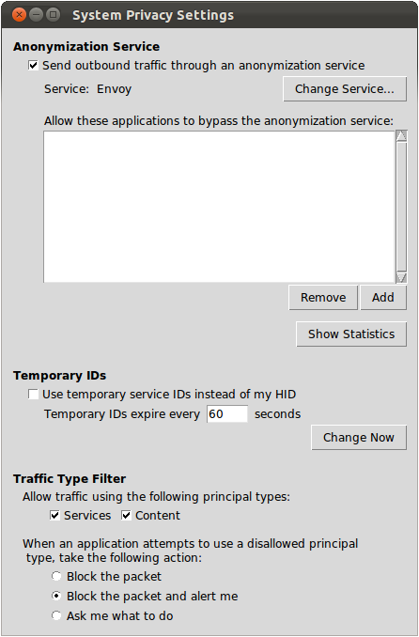
Control and Transparency
Global Controls
Control anonymity
Settings at the OS level
Notes:
First let’s look at what we’re providing to our users.
Even though it’s not XIA specific, when we’re re-architecting the Internet it’s a good time to build in things users want,
And the first thing they want is a simple way to control what their system is doing. (describe controls)
But this isn’t enough; the second thing users want is…

Slide 16
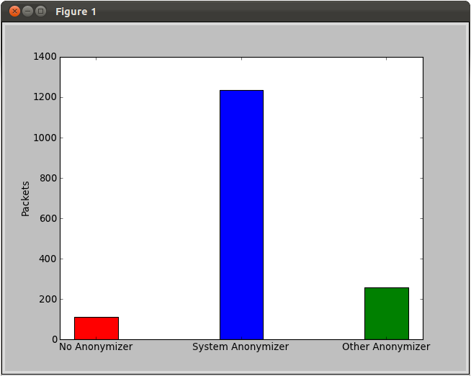
Control and Transparency
Transparency
Users can see exactly
What’s happening
Notes:
…a way to see that the system is complying with their settings.
We’re not HCI experts, but we’ve included a simplistic mockup to emphasize that users need an easy way to visualize what the system is doing.
Here, we simply report how many packets are sent through the anonymization service the user selected.
But…

Slide 17
Socket API Extension
Using these tools should be dead-easy for developers
Experienced developers should be able to do more
Xconnect(sock, dest_DAG)
XconnectCustomAnonymizer(sock, dest_DAG, anon_DAG)
XconnectWithoutAnonymizer(sock, dest_DAG)
Notes:
…what about developers?
We want applications to actually use the methods we discussed. 3 things can happen:
The developer does nothing – system automatically applies global anonymization settings
Simple way for developer to use an anonymizer if user hasn’t supplied one.
If the developer knows what he/she is doing and wants complete control over DAG, app can request an exception to bypass system anon settings.

Slide 18
Demo

Slide 19
Comparison
 | XIA | TCP/IP
Proxy-based anonymizer | In-DAG or next-header | Next-header
Temporary source IDs | Register SID with local AD Fine-grained: different temp. SID per application | Painful with static IP addresses Coarse-grained: one IP address for all processes on machine
Principal type filtering | Fine-grained traffic control | N/A

Slide 20
Questions?

